Slide 1
AI and Chess Variant
Sprint 1
Lydia Vaine, Paul Neamtu, Ryan Long, Tim Youngblood, and Souleymane Camara

Slide 2
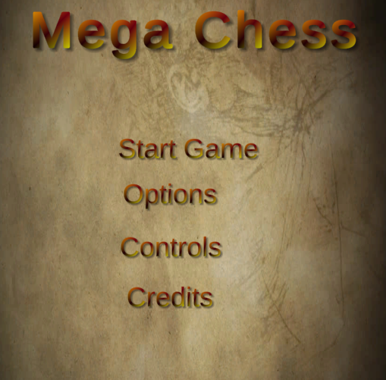
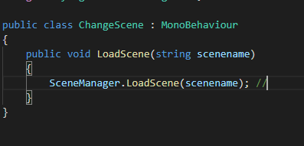
GUI Menu
Basic GUI menu with Start, Options, credits, and controls.
Start- starts the main the game scene.
Options - will transition to the Options menu scene
Credits- will transition to the credits with everyone’s name
Controls - will transition to the scene that tells the player what the controls are for the chess pieces and camera movement.
Uses a basic load scene script with a scene manager gameobject as the source to load the next scene.

Slide 3
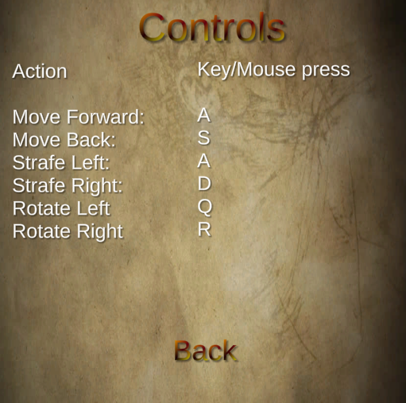
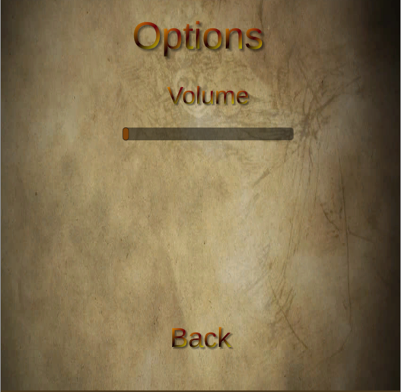
GUI cont.
The other scenes has a back button that uses the script to take the player back to the Main Menu.
The volume controls were also added
.

Slide 4
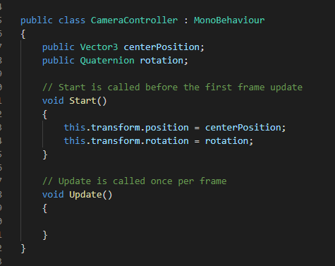
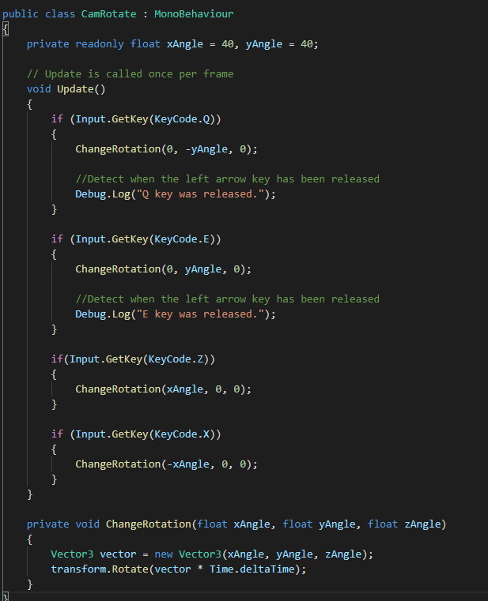
Camera with Controls
Uses two scripts one for rotation the other for movement.
Allows the player to move around their side of the board to get a closer look and make it easier to strategize against the opponent.
Movement uses WASD controls
Rotation horizontally uses Q and E. Vertical rotation uses R and F.

Slide 5
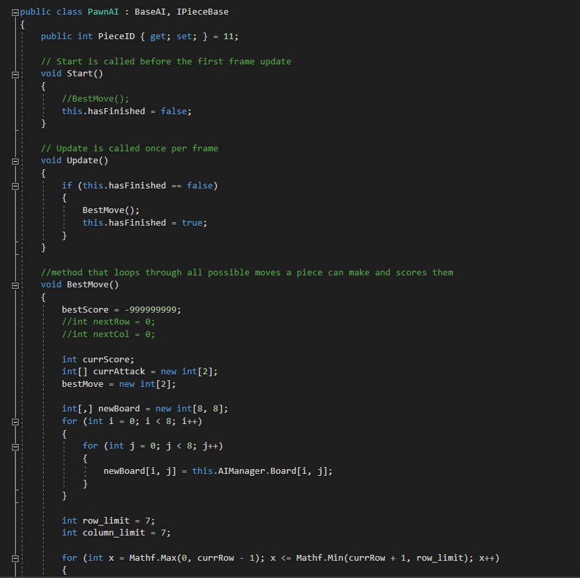
Piece AI
Each AI piece has its own AI script
This allows each piece to scan its possible moves and determine which move is best based on a heuristic
The information is stored within each piece and is fed up to the commander AI

Slide 6
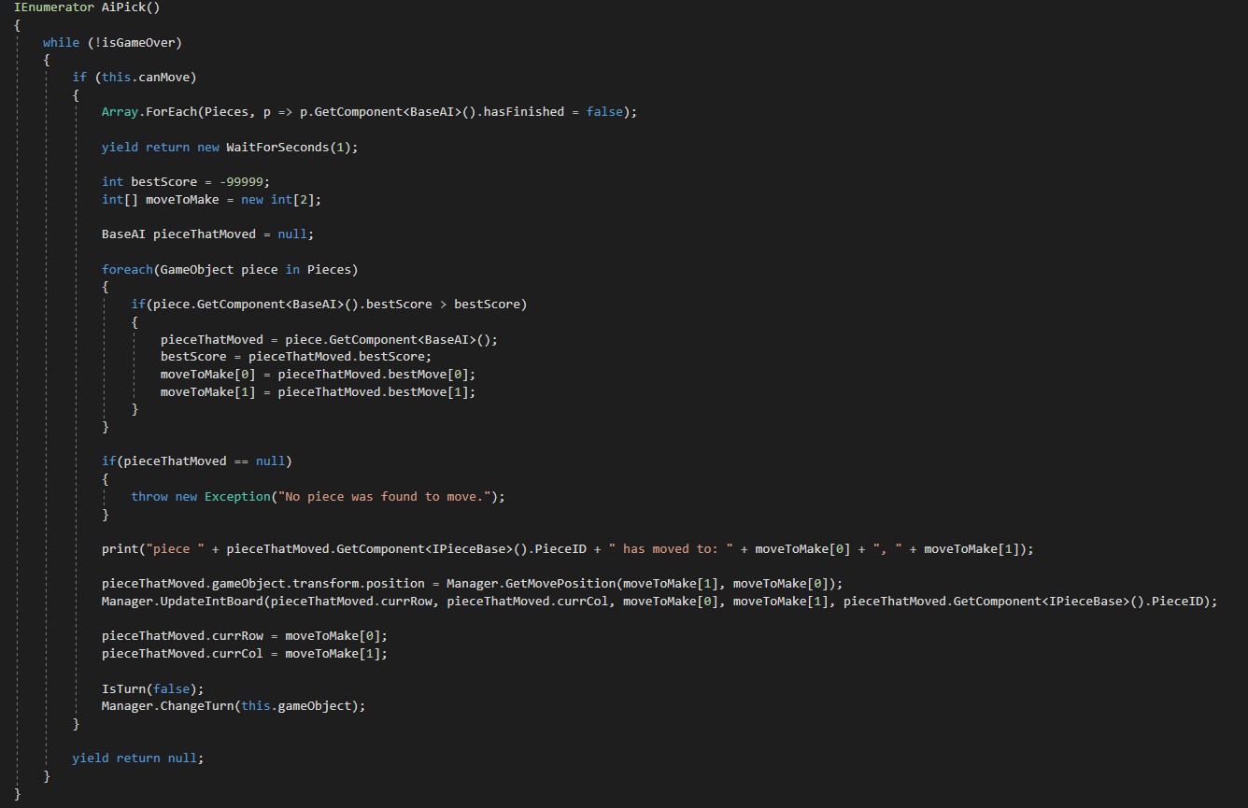
Commander AI
This script sits within the GameManager
The AI is in charge of taking information from the AI pieces and deciding what the best action is
It is also in charge of using the GameManager to update the board for AI moves

Slide 7
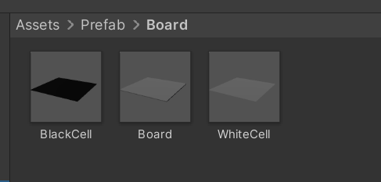
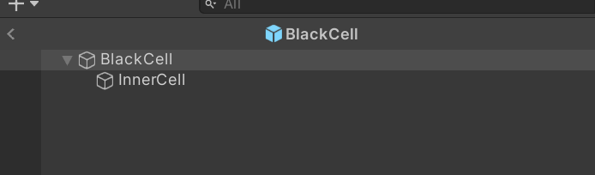
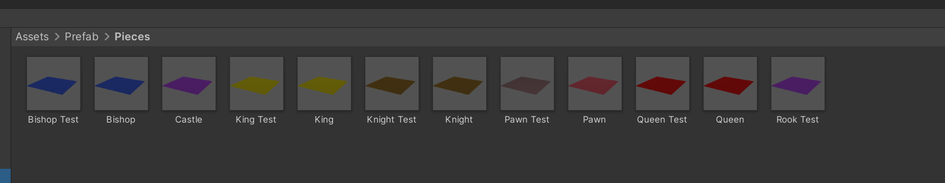
Board and Pieces
Prefabs
Instantiated by Game Manager at Start
Pieces are created and assigned to players by the Game Manager at Start
Each Piece has its own movement script

Slide 8
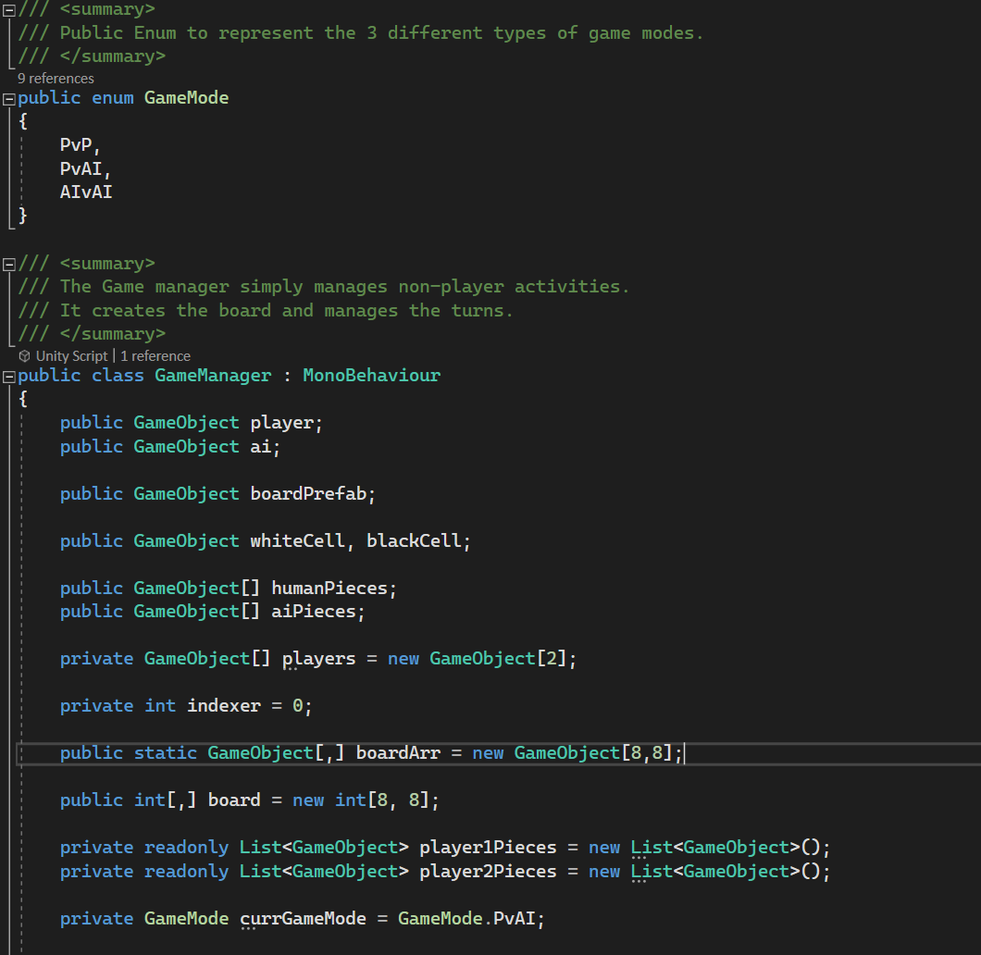
Game Manager
Empty GameObject in the Scene
Contains GameMode Enum
Builds and instantiates the board
Instantiates pieces and players (based on game mode)
Assigns pieces to players
Keeps track of board state
Keeps track of player turn

Slide 9
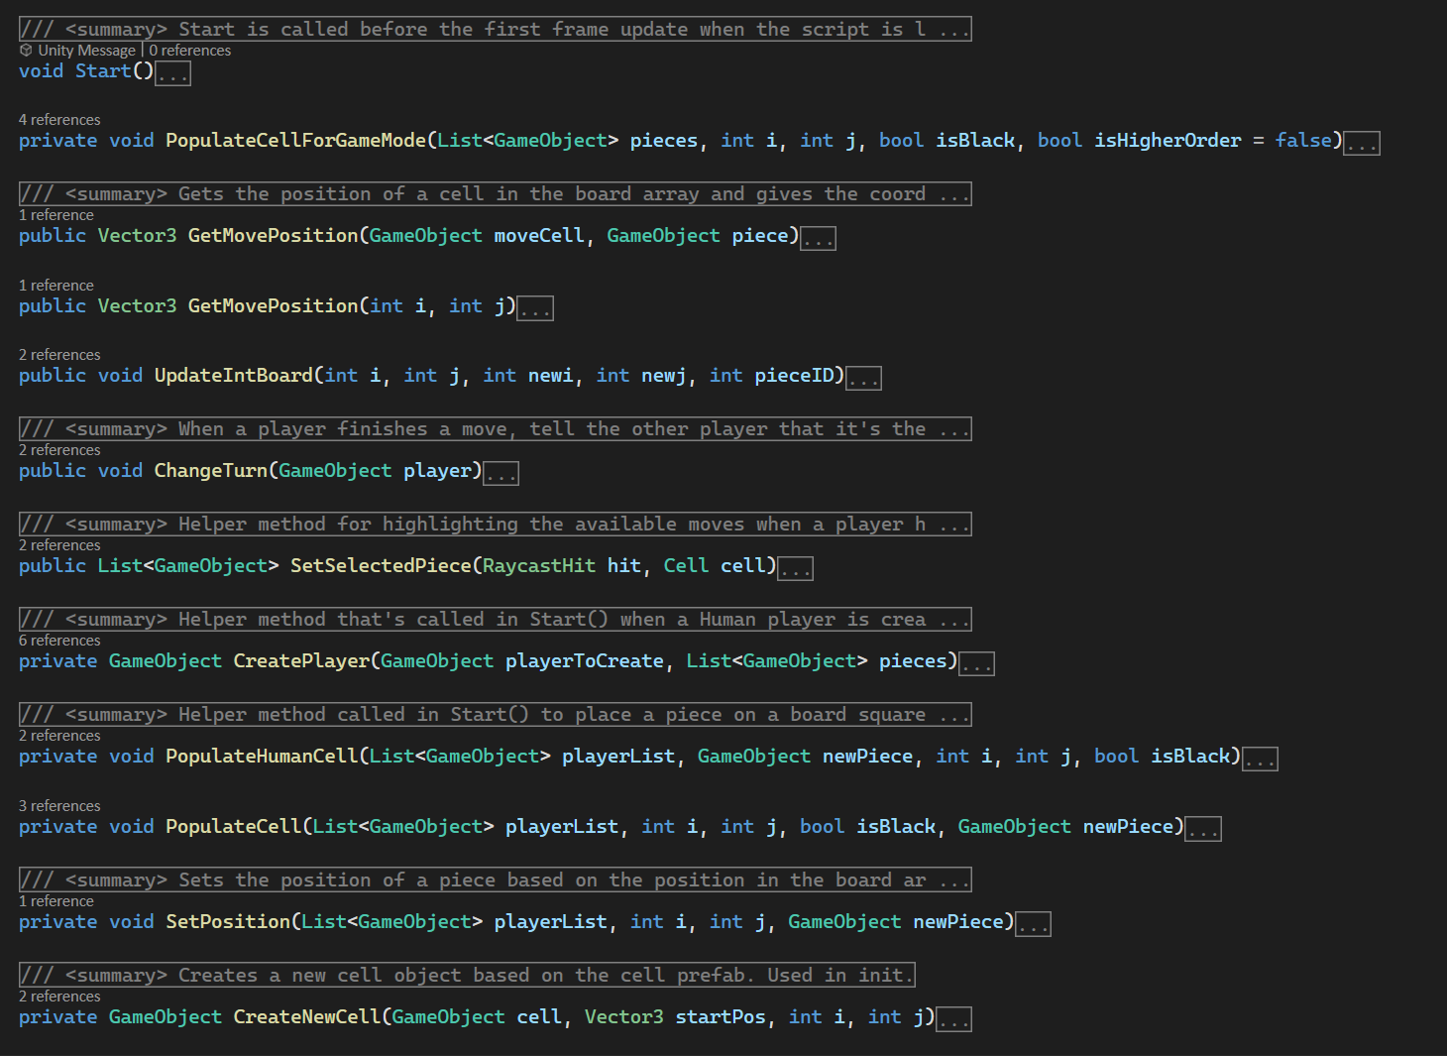
GameManager Cont.

Slide 10
Classes and Inheritance for Game Pieces
Pieces:
AI Pieces - BaseAI
Player Pieces - BasePiece
IPieceBase
Players:
Base Player

Slide 11
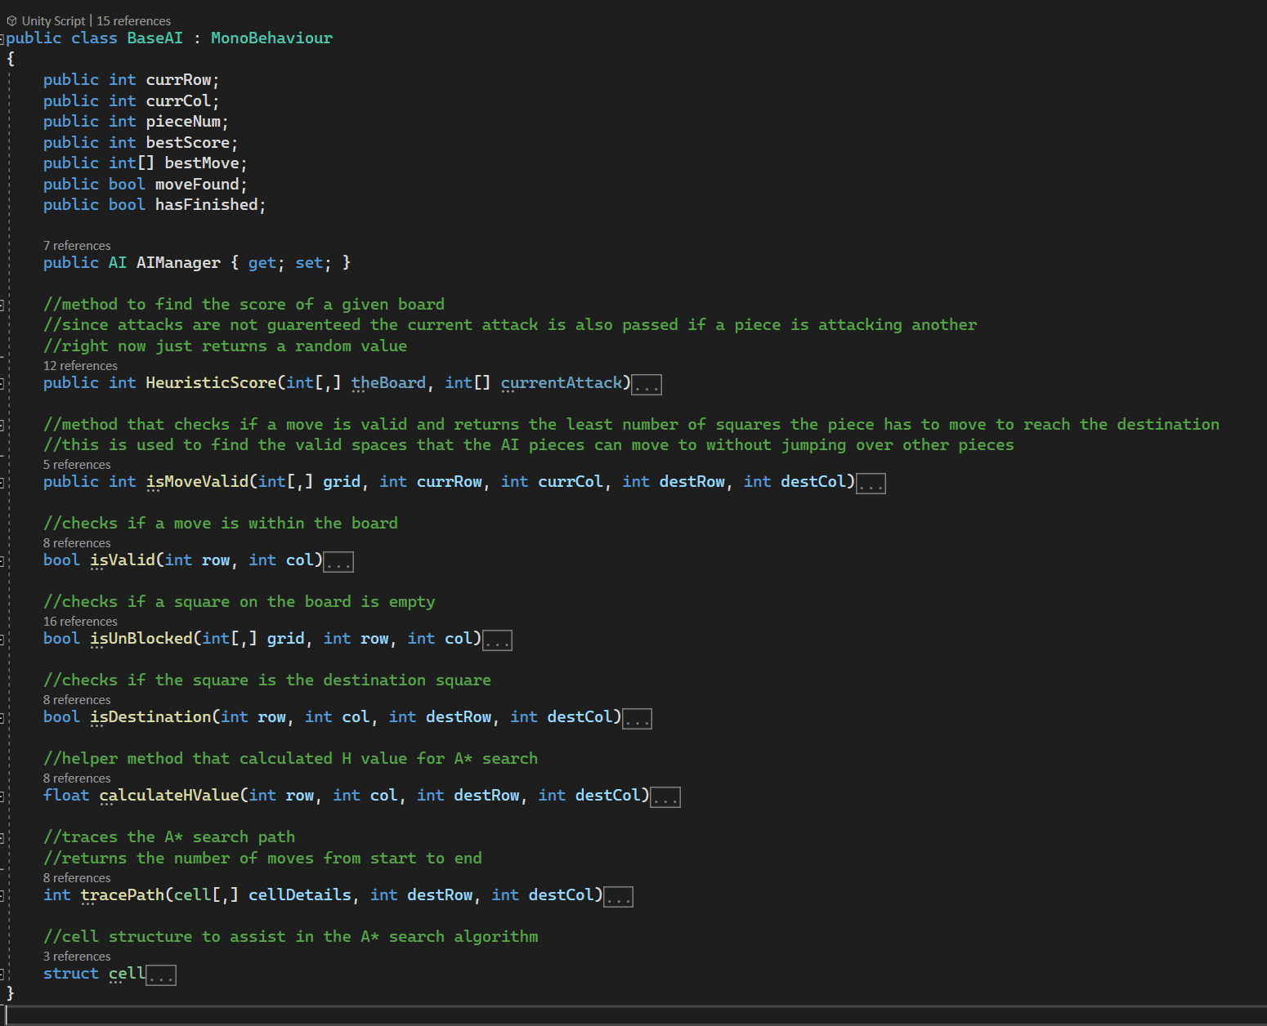
BaseAI

Slide 12
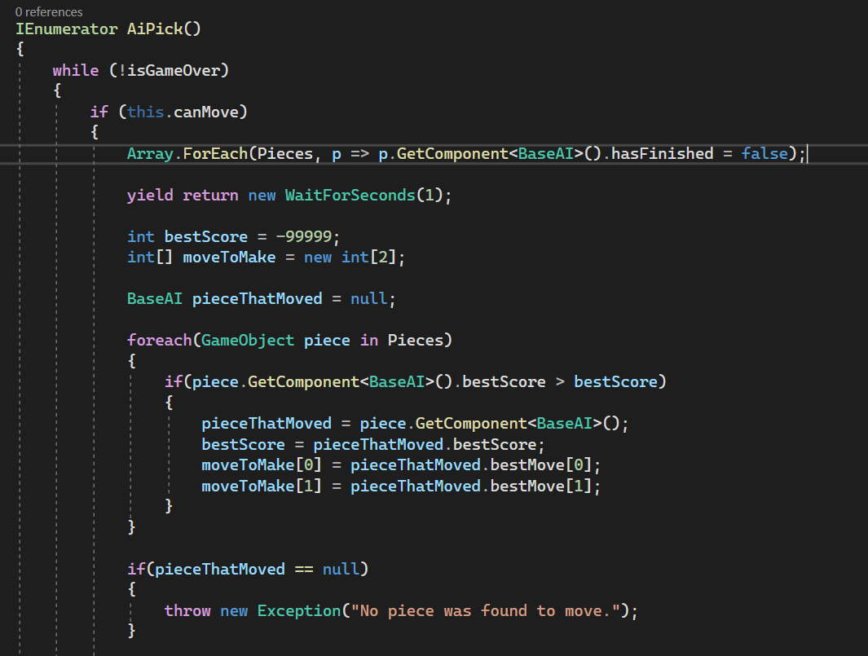
BaseAI - Usage

Slide 13
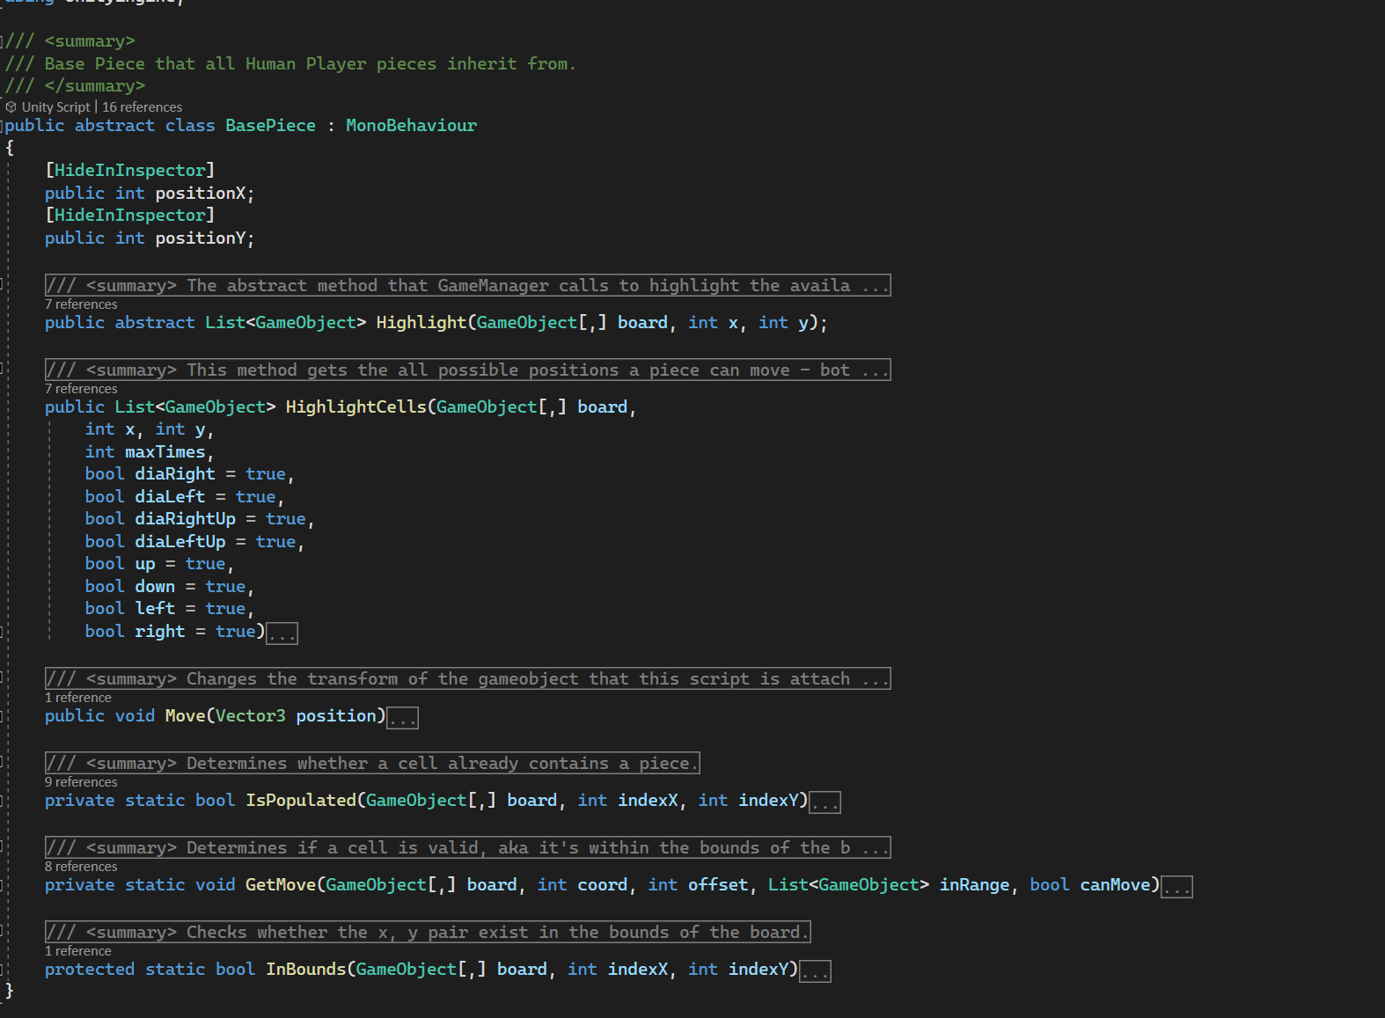
BasePiece

Slide 14
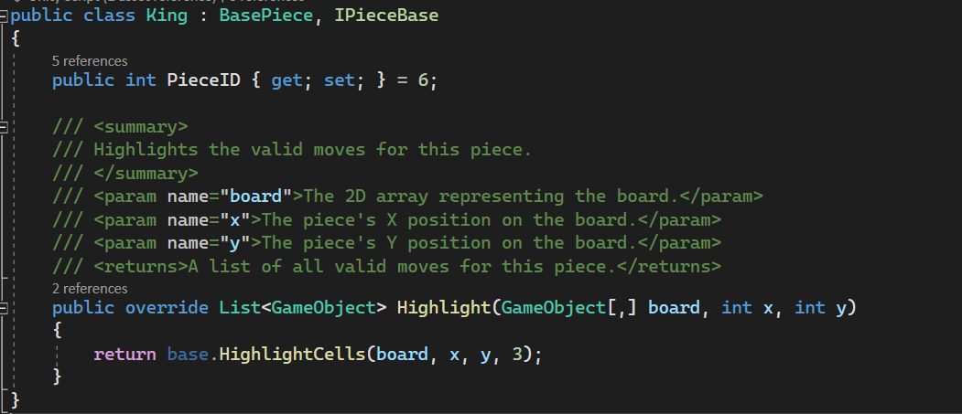
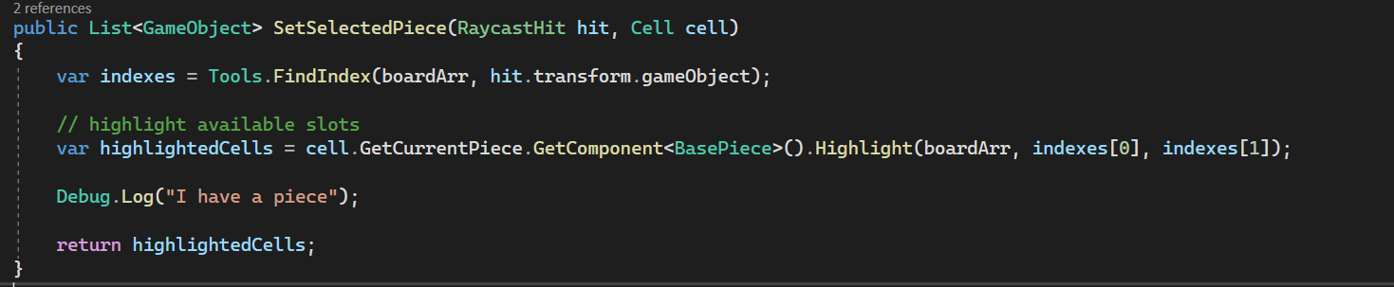
BasePiece
Usage

Slide 15
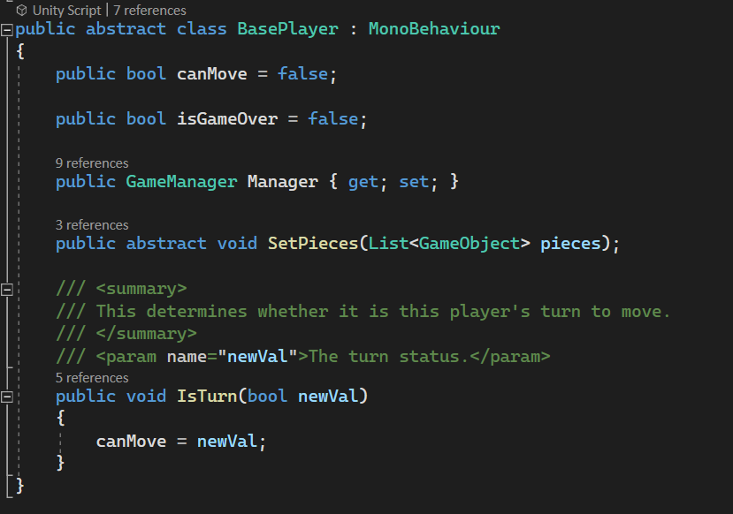
BasePlayer

Slide 16
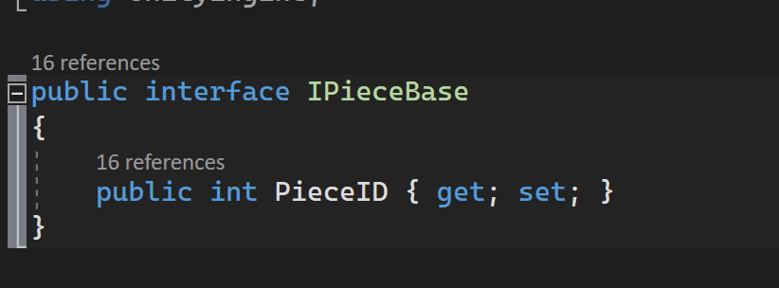
IPieceBase

Slide 17
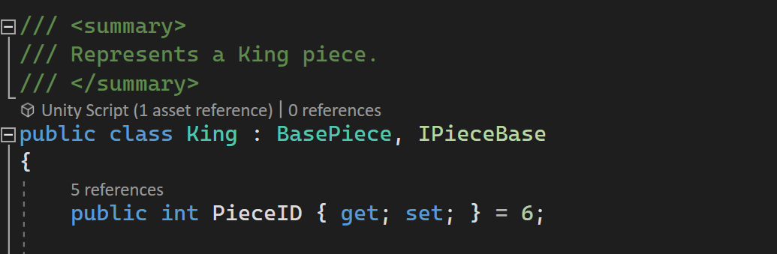
IPieceBase Usage
Usage:

Slide 18
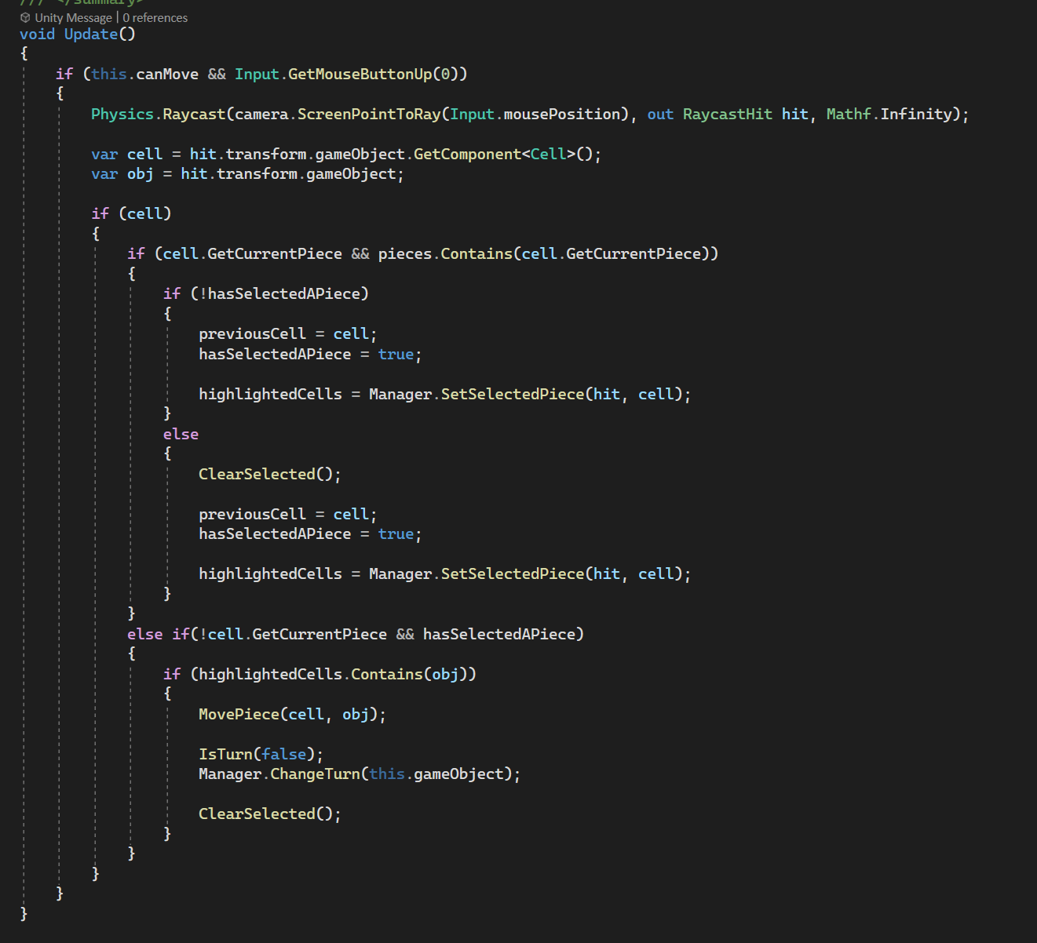
Player Movement
Click on piece to select
Highlights valid moves on the board for the selected piece
Click on a highlighted square to move the piece

Slide 19
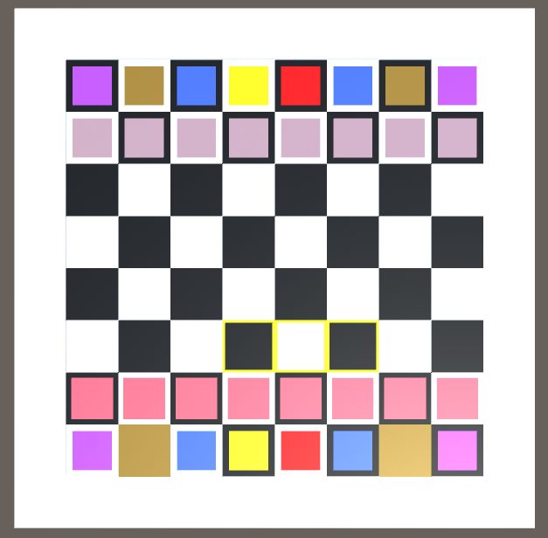
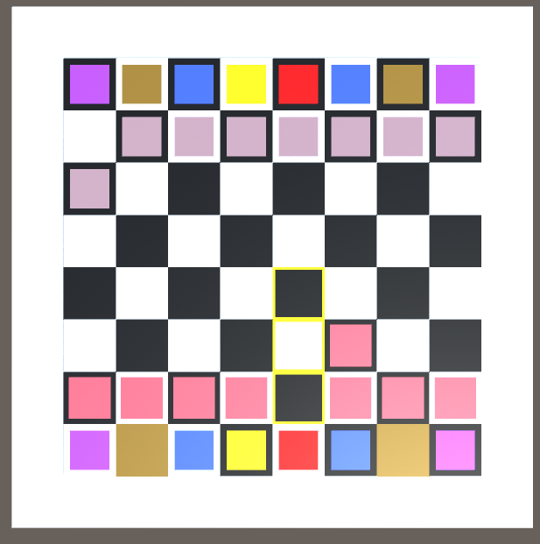
Player Movement Cont.

Slide 20
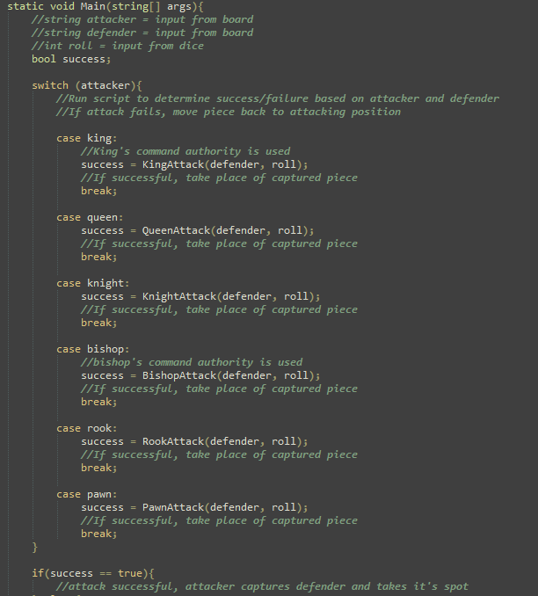
Attack/Capture Algorithm
General purpose: Determine success of attack
Uses variables from game board (attacker and defender)
Runs switch() to use game piece identity to call the correct method
Uses die roll and game piece data to determine success or failure
Snippet of attack script.

Slide 21
Rolling a Die
The die Roll is needed to capture a piece depends on the combination of the attacking piece and the defending piece.

Slide 22
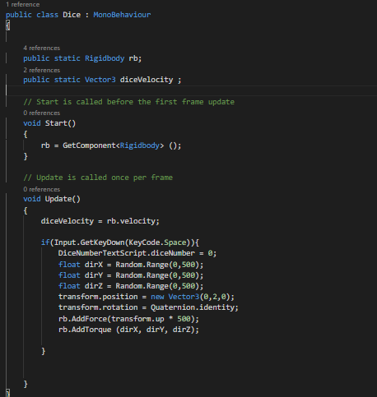
Dice
This script sets rigidbody to die in order to be able to receive forces and torque to make the die moves in a realistic way.
It also adds velocity to the die.
And set the space key so as every time you press on it the the die bounces

Slide 23
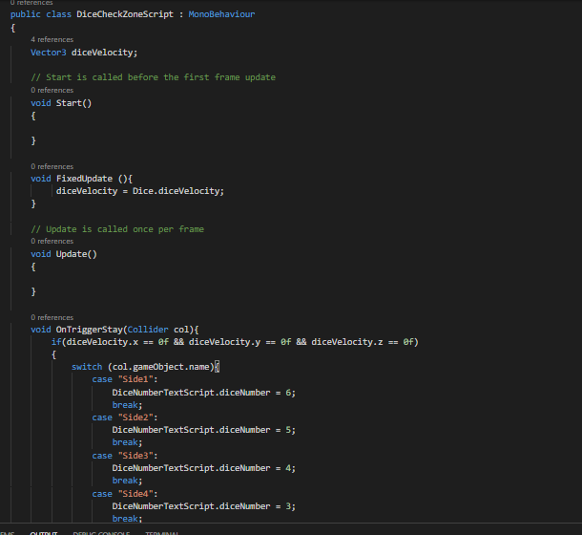
DiceCheckZone
This script basically captures the different sides of the die on which the die can potentially fall on.
We set different positions for all the six sides of the die.
And also set the OntriggerStay function so that each time a side falls on the ground, then display the top of it by making sure the die velocity is 0 on every position.

Slide 24
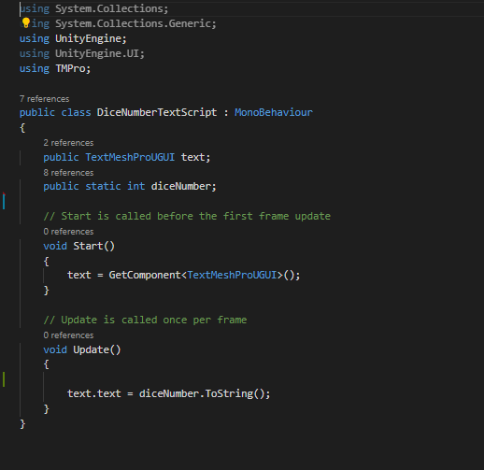
DiceNumberTextScript
This script displays the number on top of the die each time a number is rolled.

Slide 25
